Slide 1
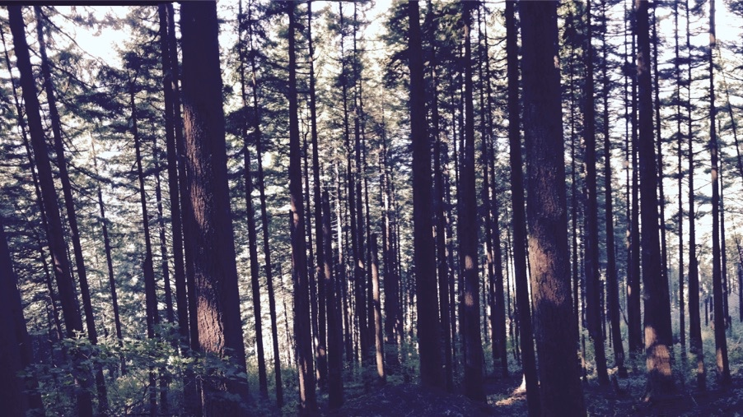
Photosynthetic acclimation to global change: improved understanding for more reliable predictions
Nick Smith
Texas Tech University
nick.smith@ttu.edu

Slide 2



Thank you
ESA for selecting me as an Early Career Fellow
Our amazing lab and scientific network
Lizz Waring and Evan Perkowski (ECF nominators)

Slide 3
Learning from mentees to better understand your science and your self
Nick Smith
Texas Tech University
nick.smith@ttu.edu

Slide 4
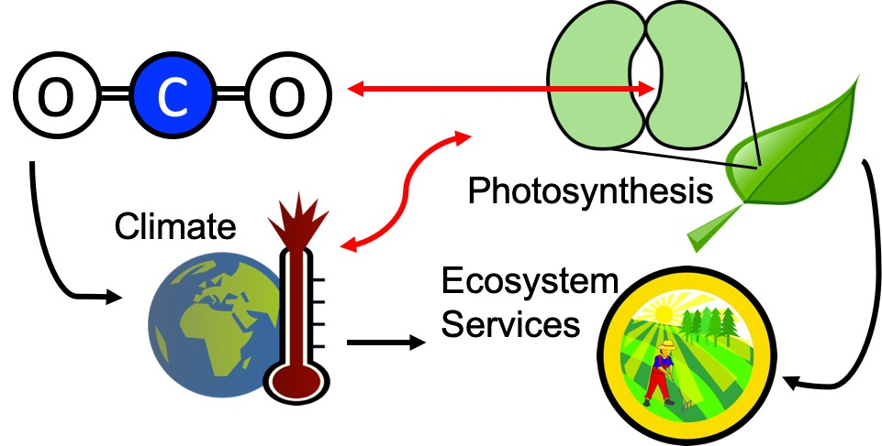
Our lab examines photosynthesis as a regulator of global change impacts on ecosystem services

Slide 5
Photosynthesis provides the foundation for other services
FNAL

Slide 6
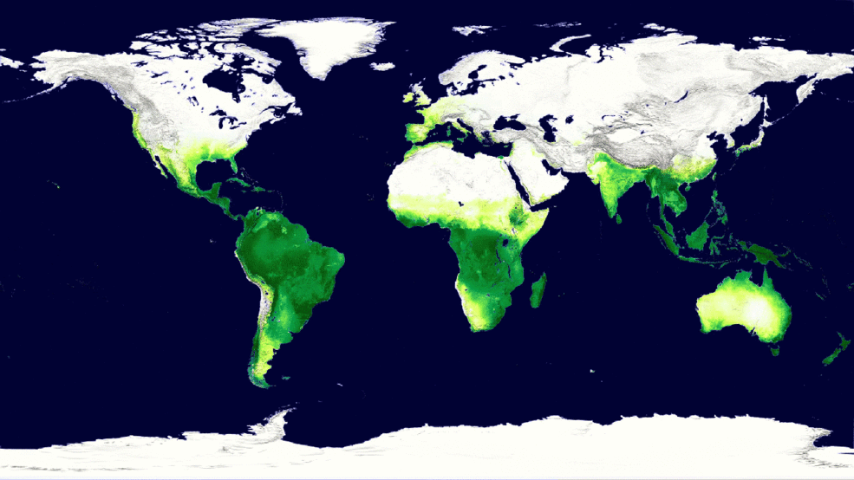
Photosynthesis is a dynamic process that is likely to be impacted by global change
MODIS, NASA

Slide 7
But predictions are uncertain!
Friedlingstein et al. (2014)

Slide 8
But predictions are uncertain!
Future model uncertainty (14 Pg) > current fossil fuel emissions (9.5 Pg)
Friedlingstein et al. (2014)

Slide 9
This uncertainty is driven by uncertainty in photosynthesis
Friedlingstein et al. (2014)
Keenan et al. (in review)

Slide 10

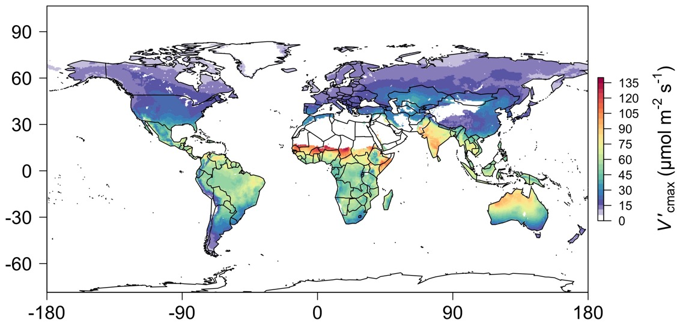

When starting the lab in 2017, I “knew” I had the answer!
photosynthetic capacity
Photosynthetic capacity
photosynthetic capacity
Smith et al. (2019)

Slide 11

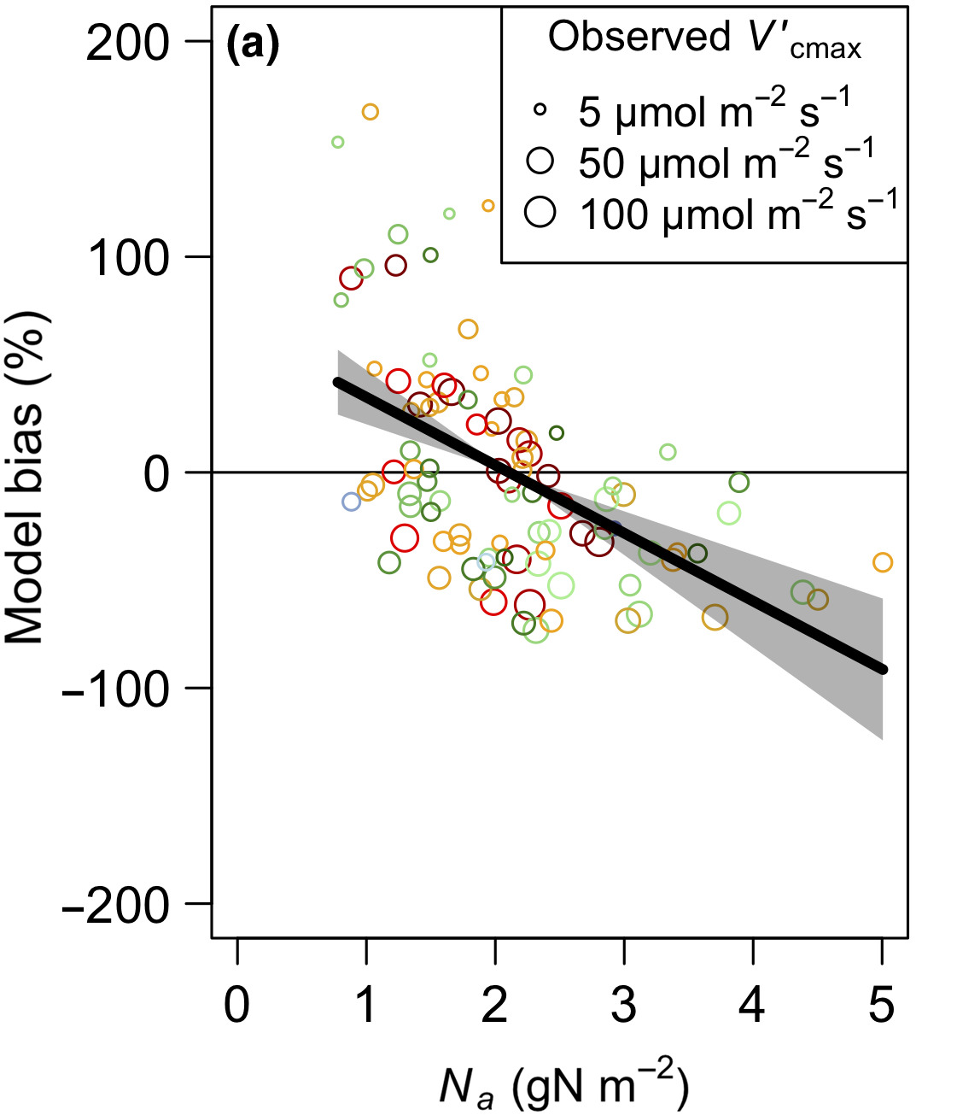

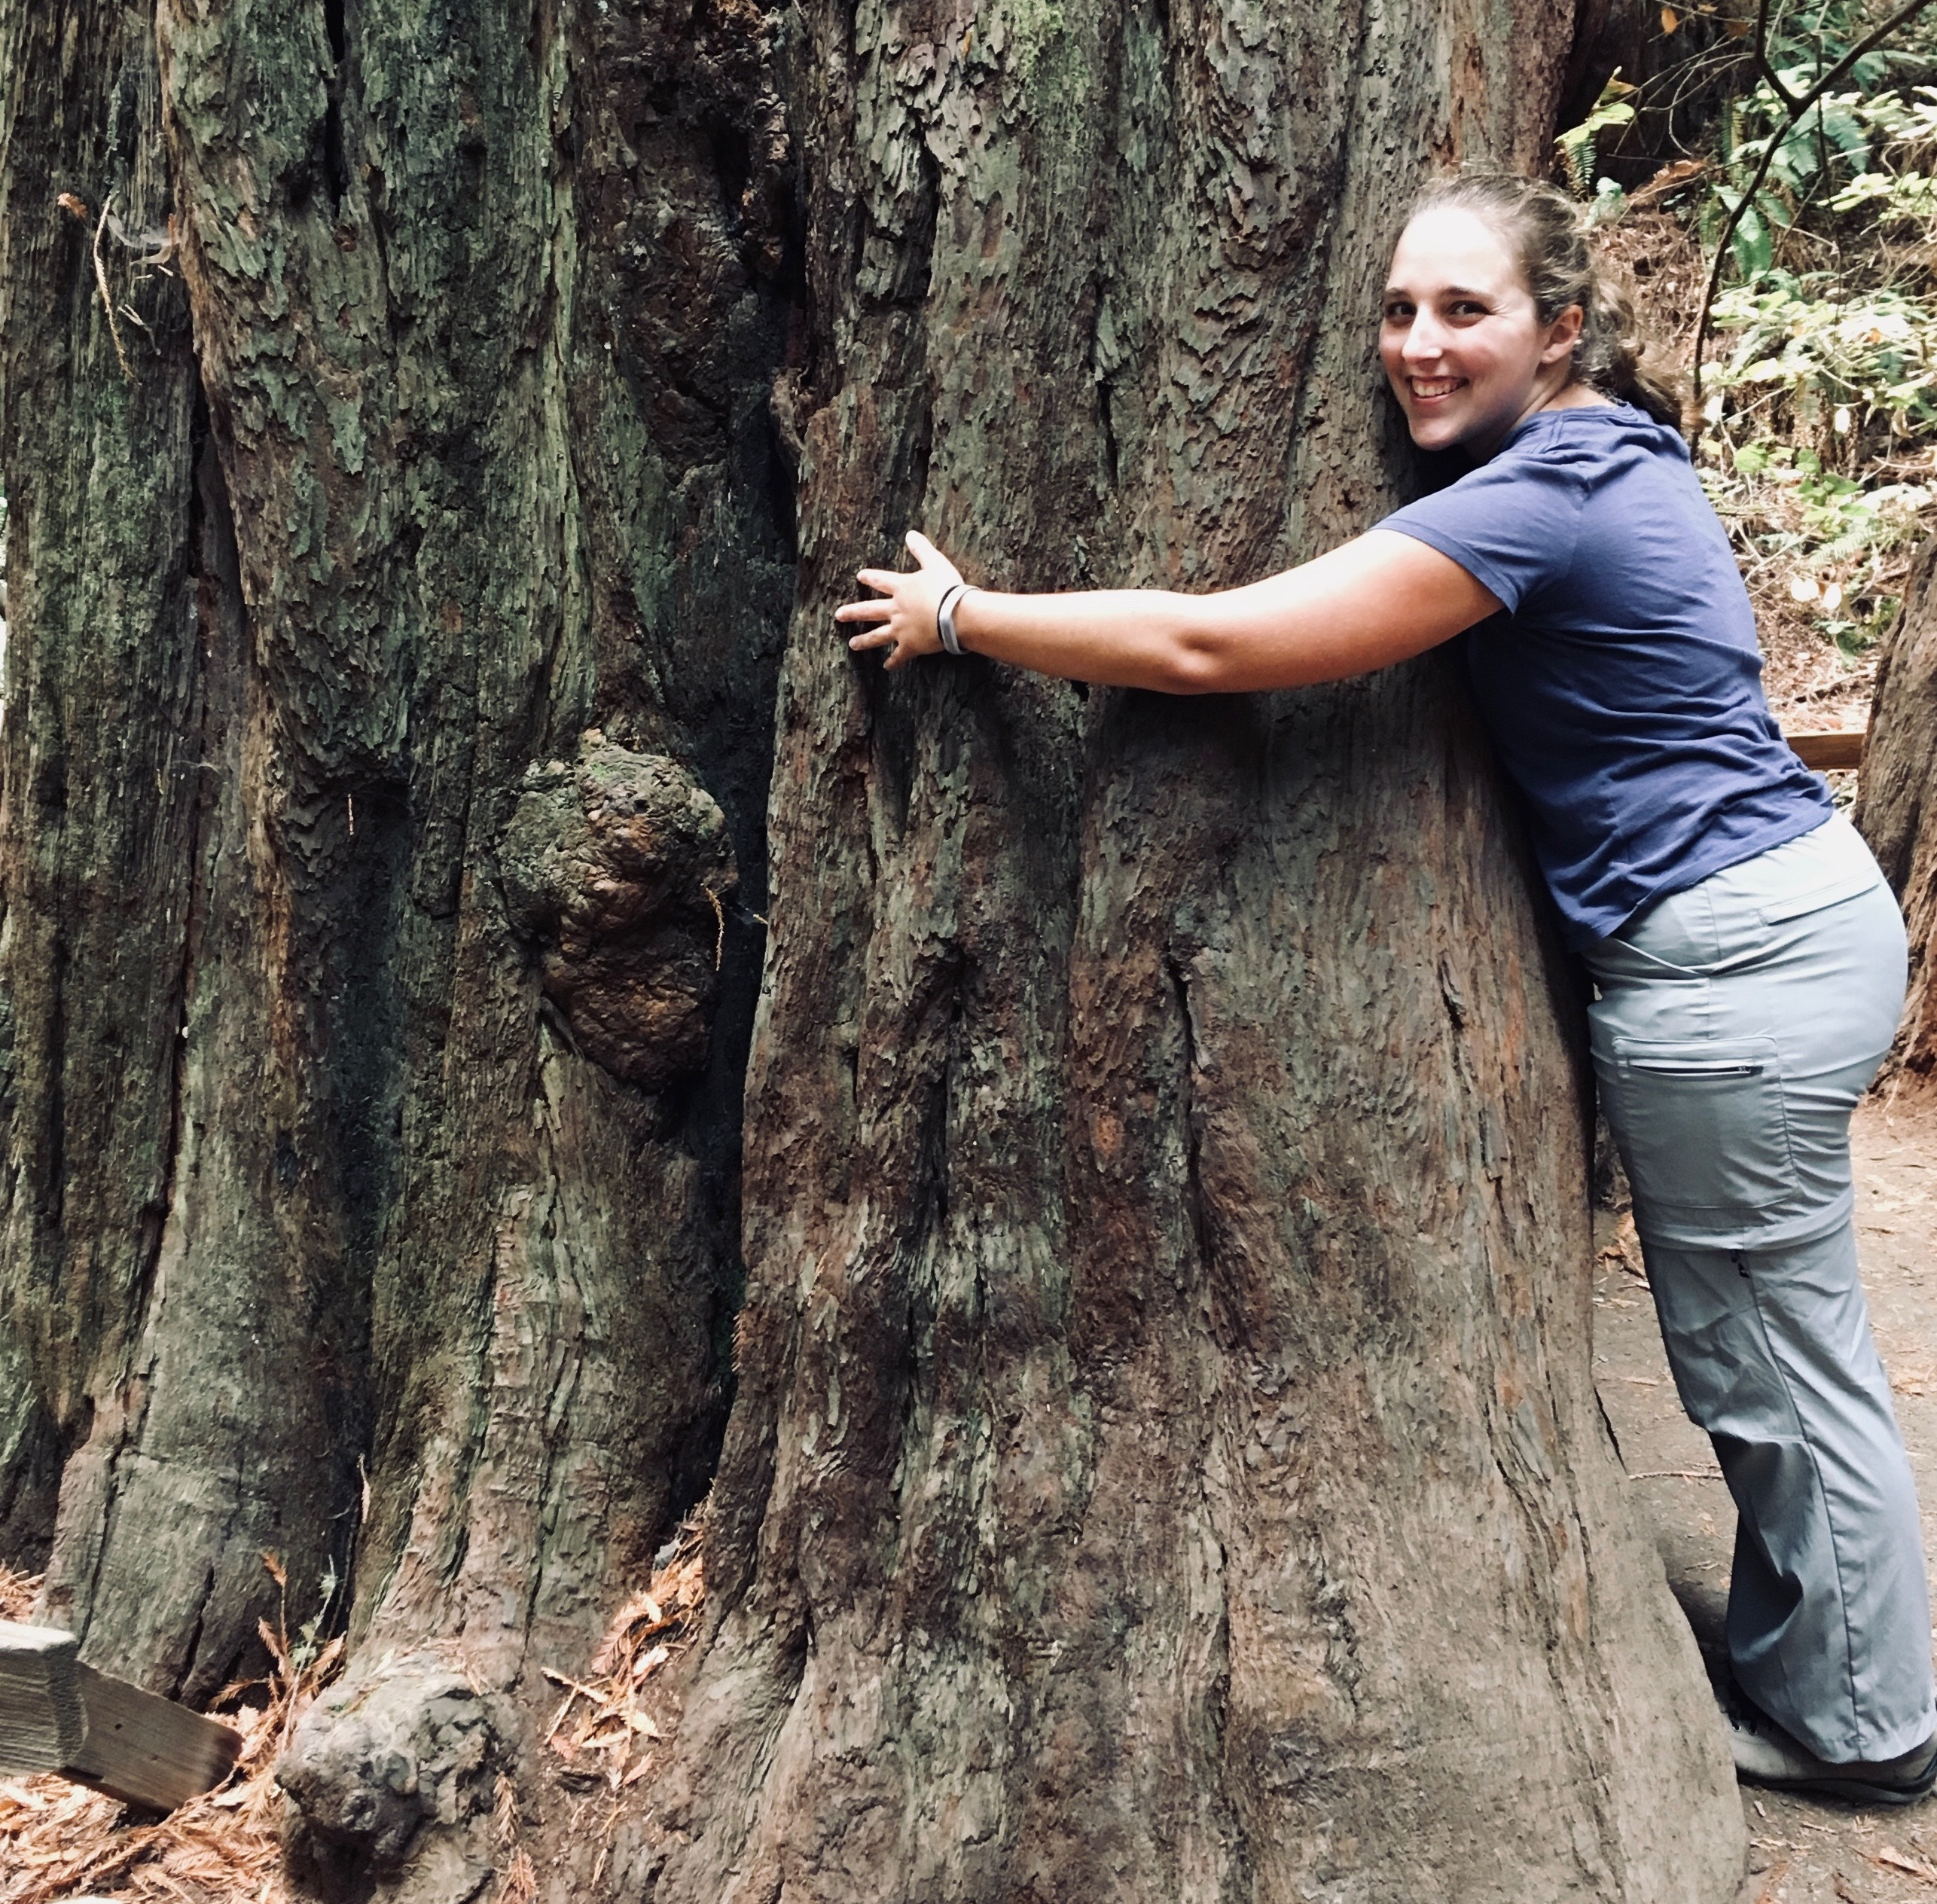
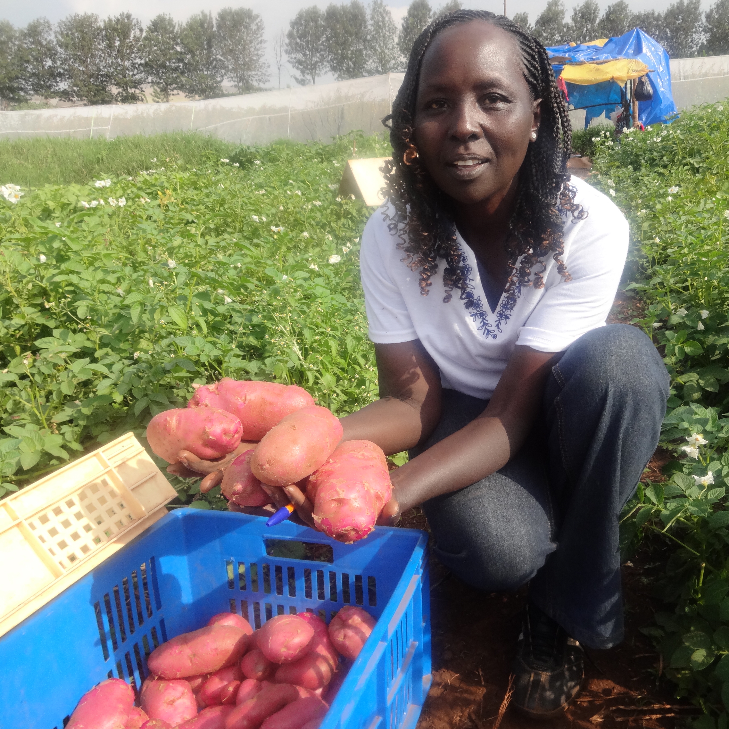

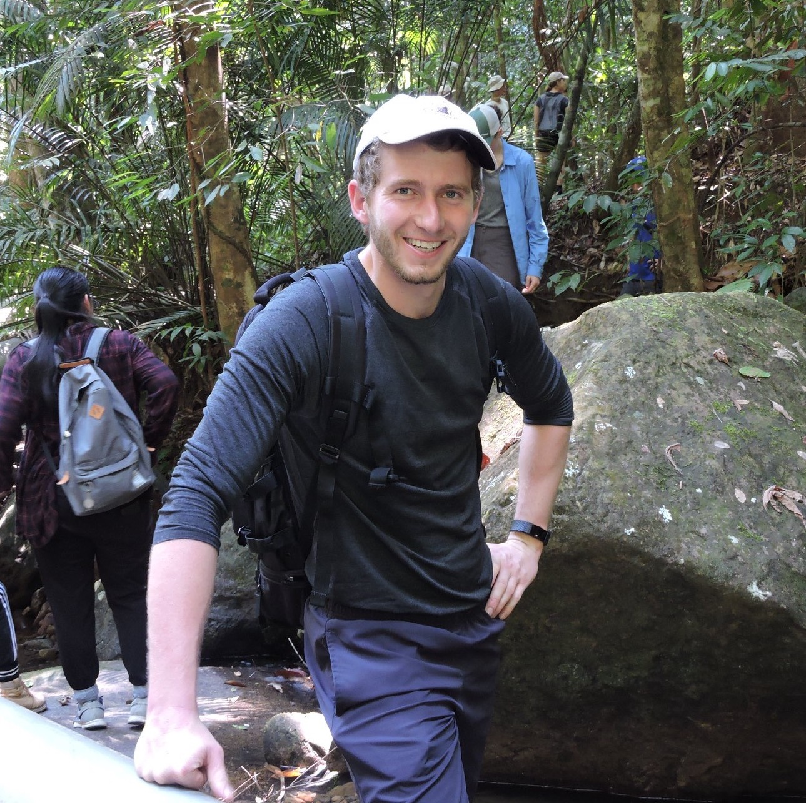
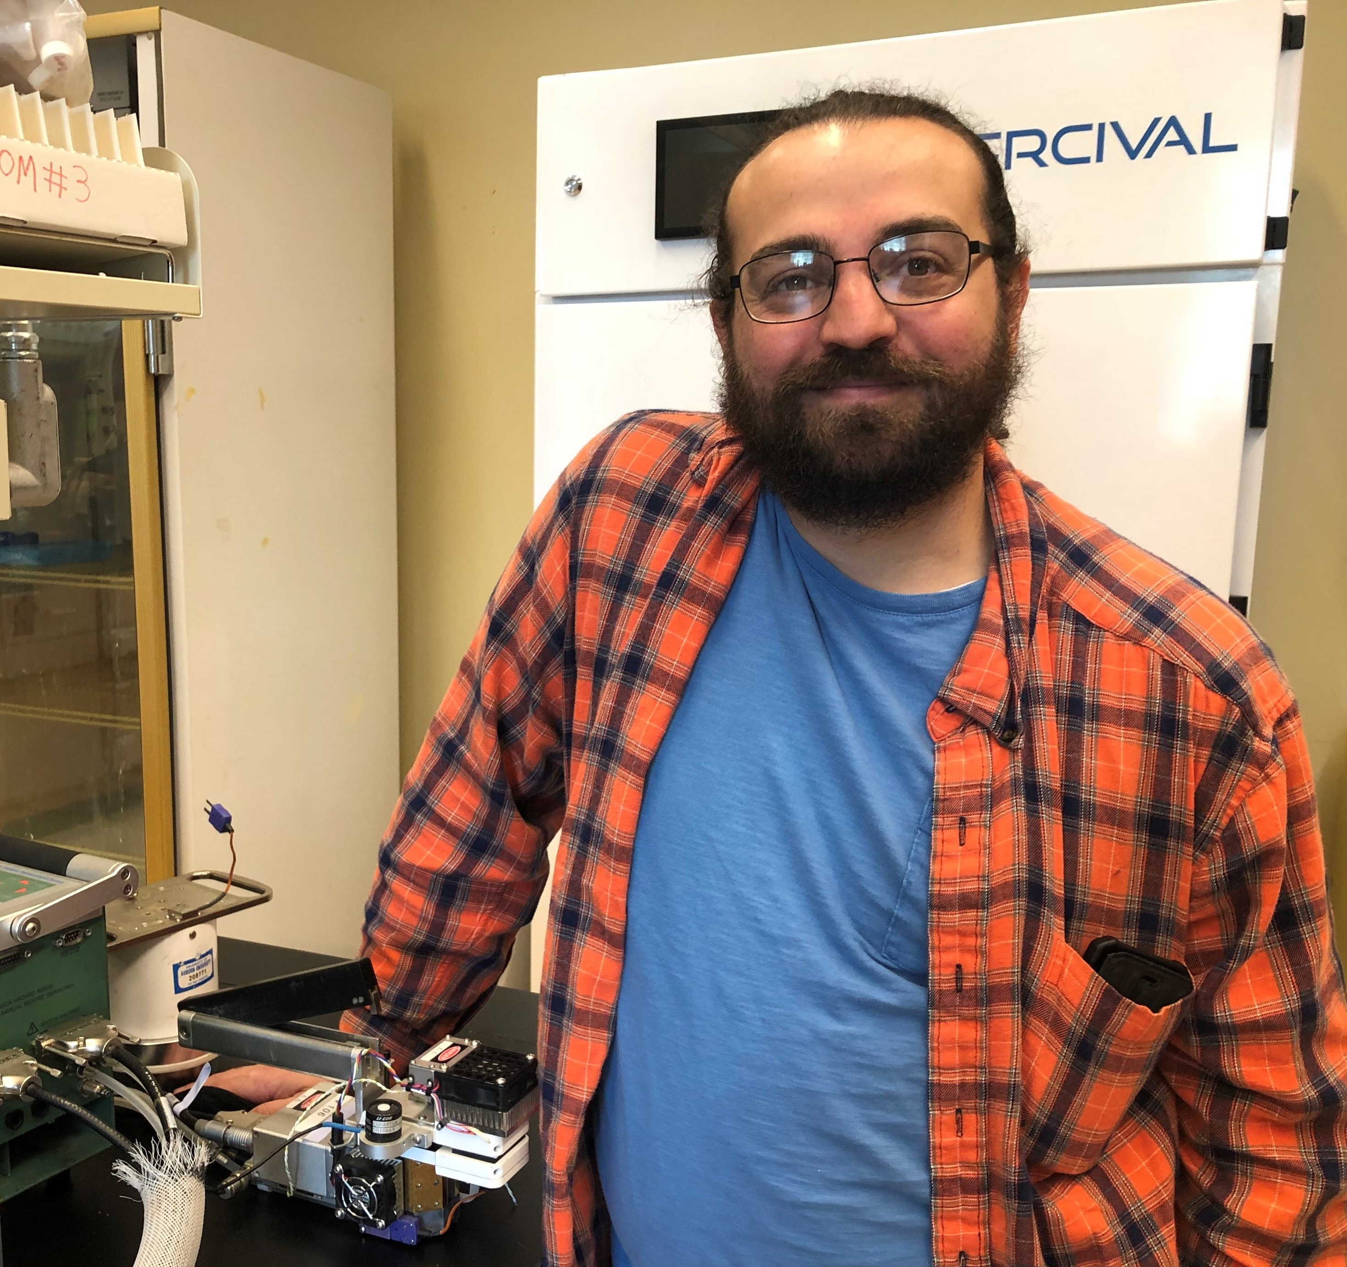



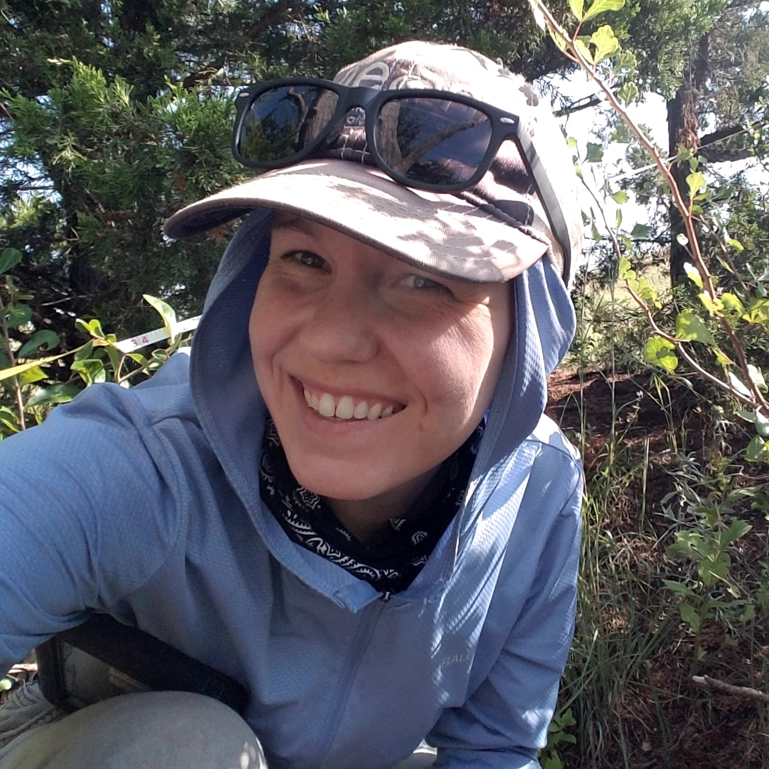
Not everyone agreed
Photosynthetic capacity

Slide 12
Questioning Nick’s worldview
Nick: photosynthetic capacity is primarily demand-driven
Others: nutrient availability matters too!

Slide 13
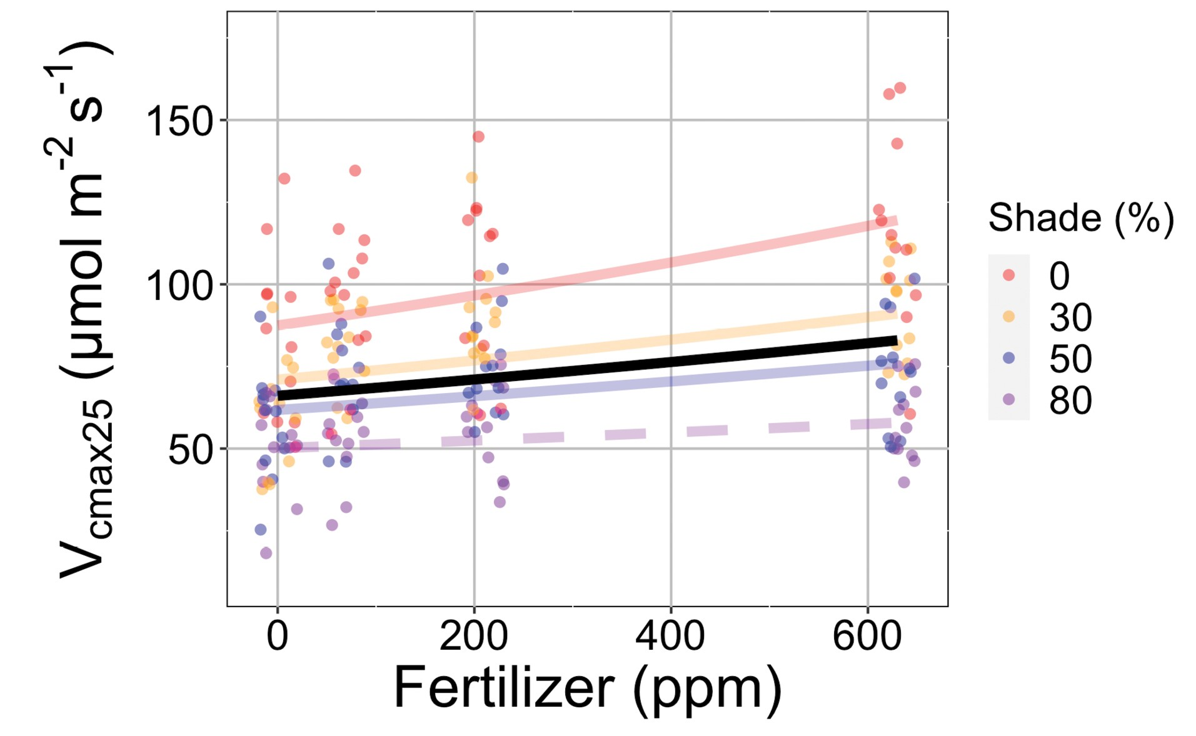
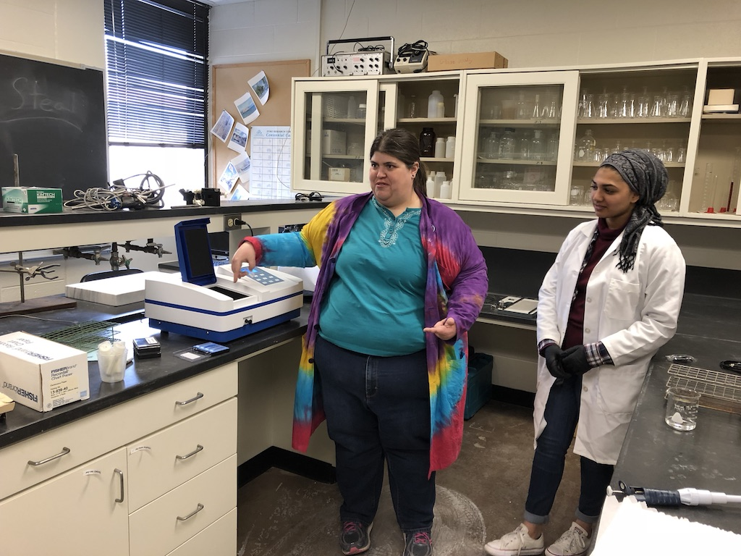
Scientific lesson: nutrient availability and nutrient demand drive photosynthetic capacity
N demand
Photosynthetic capacity
N availability
Waring et al. (2023)

Slide 14
Scientific lesson: nutrient demand increases responses to nutrient availability
ALISSAR’S ∆NMASS SCATTERPLOTS

Slide 16
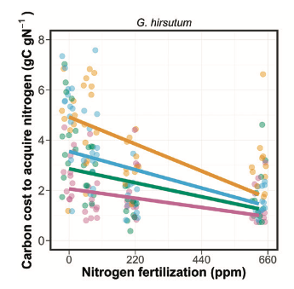
Scientific lesson: nutrient availability reduces carbon costs to acquire them
Perkowski et al. (2021)

Slide 17
Questioning Nick’s worldview
Nick: photosynthetic capacity is primarily demand-driven
Others: nutrient availability matters too!
Nick: plants uptake nutrients to meet photosynthetic demand
Others: plants uptake nutrients for lots of other things!

Slide 18
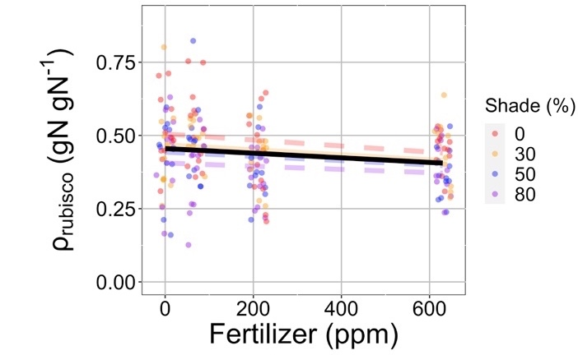
Scientific lesson: nutrient availability doesn’t just influence photosynthesis
Fraction N in Rubisco
*Consistent across multiple species, metrics, and growth conditions
Waring et al. (2023)

Slide 19
Questioning Nick’s worldview
Nick: photosynthetic capacity is primarily demand-driven
Others: nutrient availability matters too!
Nick: plants uptake nutrients to meet photosynthetic demand
Others: plants uptake nutrients for lots of other things!
Nick: plants downregulate photosynthetic capacity under elevated CO₂ to optimize nutrient use

Slide 20
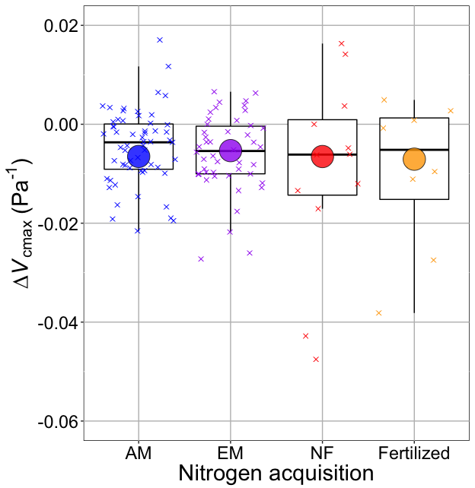
V_{cmax} changes with CO₂ in ways expected from optimization
Boxes = data = -0.0063 Pa⁻¹
Circles = predicted = -0.0066 Pa⁻¹
Smith and Keenan (2020)

Slide 21
Questioning Nick’s worldview
Nick: photosynthetic capacity is primarily demand-driven
Others: nutrient availability matters too!
Nick: plants uptake nutrients to meet photosynthetic demand
Others: plants uptake nutrients for lots of other things!
Nick: plants downregulate photosynthetic capacity under elevated CO₂ to optimize nutrient use
Others: elevated CO₂ responses are the result of interactions between photosynthetic demand, nutrient availability, growth, and allocation

Slide 22
Scientific lesson: ok, maybe photosynthetic demand decreases regardless of other interactions
EVAN’S VCMAX FIGURE

Slide 23
Scientific lesson: nitrogen availability still matters independently
EVAN’S VCMAX AND X FIGURE

Slide 24
PLUG EVAN’S TALK

Slide 25
Questioning Nick’s worldview
Nick: photosynthetic capacity is primarily demand-driven
Others: nutrient availability matters too!
Nick: plants uptake nutrients to meet photosynthetic demand
Others: plants uptake nutrients for lots of other things!
Nick: plants downregulate photosynthetic capacity under elevated CO₂ to optimize nutrient use
Others: elevated CO₂ responses are the result of interactions between photosynthetic demand, nutrient availability, growth, and allocation
Nick: we only need to worry about modeling C₃ acclimation
Others: C₄ plants are dynamic and important!

Slide 26
Scientific lesson: C₄ dynamism can be simulated

Slide 27
Scientific lesson: C₄ dynamics are likely important for predicting community change

Slide 29
Larger lessons learned from mentees about myself and approach to science

Slide 30
Larger lesson: read with, discuss with, debate with, and listen to mentees

Slide 31
Lesson: reserve and prioritize time to teach and train
Notes:
Not only fulfilling, but it helps you to learn

Slide 32
Lesson: value different skillsets and ideas

Slide 33
Lesson: help mentees achieve their goals, not yours
Notes:
Not only fulfilling, but it helps you to learn

Slide 34
Lesson: go slow

Slide 35
Lesson: be humble, be kind

